Slide 1

How do we revise?
Help! I don’t know how to revise!

Slide 2
What is the point of revision?
It is to remember things.
The best way to remember is through cues.
A cue is something that you associate with something else.

Slide 3

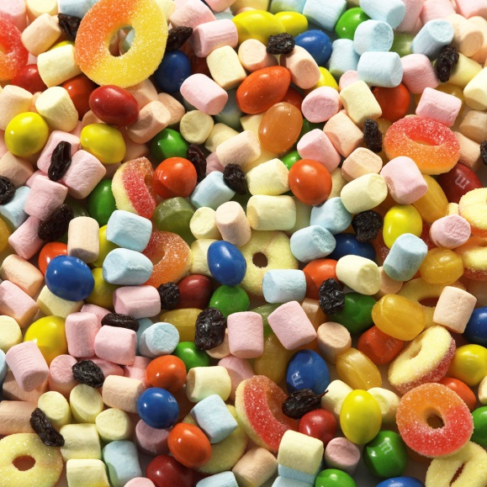

Colour, Smell, Taste, Sound
All things that you have at your fingertips.

Slide 4
The first rule of revision:
Don’t worry.
Worrying will put you off and stop you from doing anything at all.

Slide 5
Second rule of revision
Do not take the easy option and go over things that you already know.
This might make you
feel better
(and boost your
confidence) but
actually is of no
benefit.

Slide 6
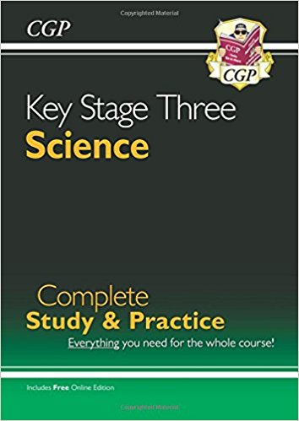
Third rule of revision
Find out exactly what you need to know!
Look at the textbook or revision guide – this will often summarise what you need to know.

Slide 7

Final Rule:
Plan your revision. There’s no point in trying to cram too much in.
You know when your exam is. What will you need to cover by that date?

Slide 8
How can I revise then?
Everyone is different and so you all have different things that work for you.
It isn’t a good idea to write out all of your notes all over again. There are so many things you can try:

Slide 9


Revision Cards

Slide 10
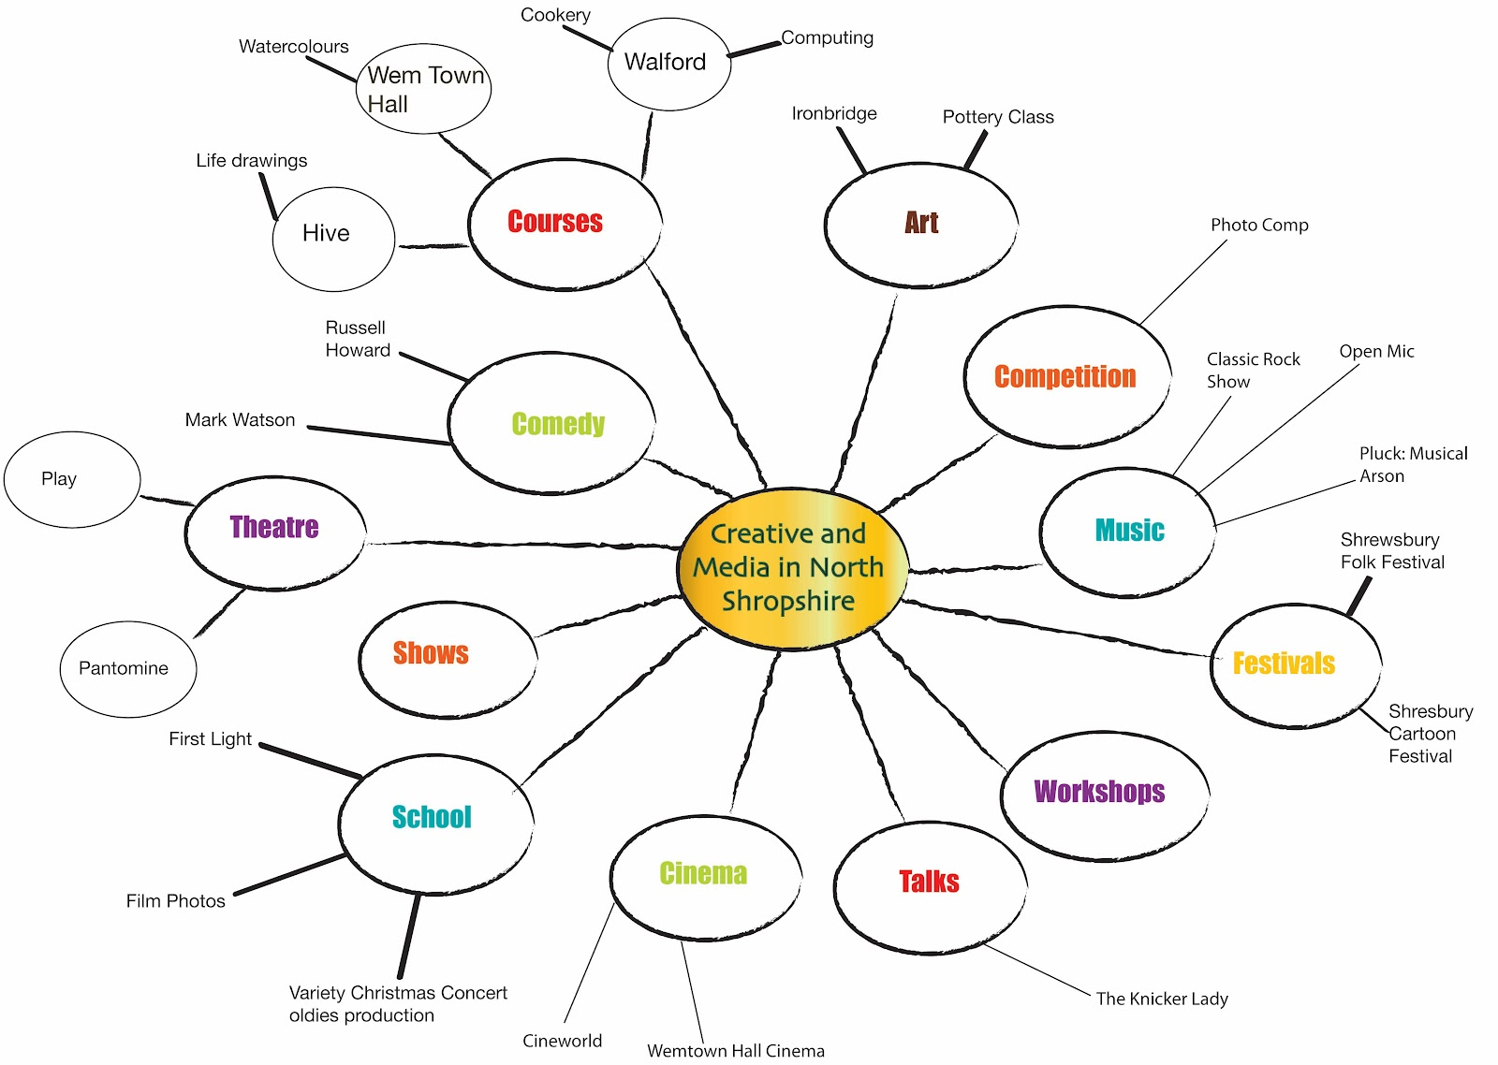
Mind Maps

Slide 11
Mnemonics
Or try:
Rhymes
Songs
Happy Henry Likes Beer But Could Not Obtain Four Nuts
That gives us the first 10: Hydrogen, Helium, Lithium, Beryllium, Boron, Carbon, Nitrogen, Oxygen, Fluorine, Neon.

Slide 12
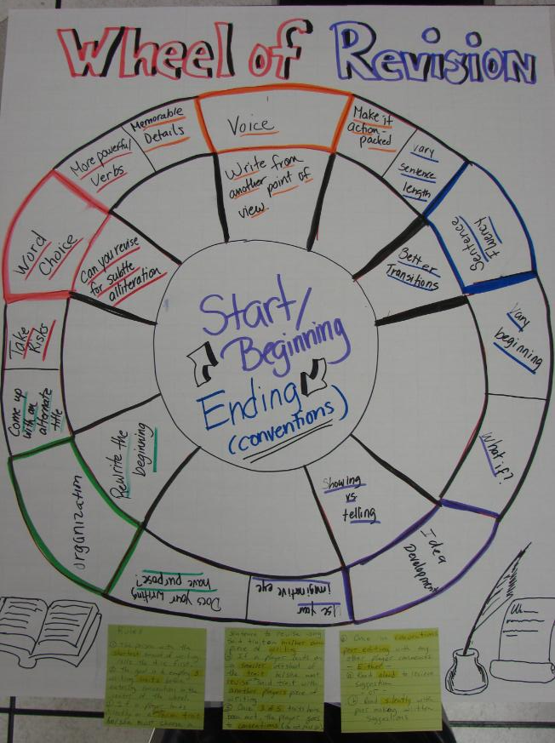
Games
Snap
Pairs
Internet games

Slide 13

Use post it notes
All around your house – put keywords in the toilet, on your bedroom wall, on your tv etc.

Slide 14

Read out loud
Record the information onto your iThingy or your phone.
Play it back when you are going to sleep.

Slide 15

The Interweb
There are masses of resources available online:
- BBC Bitesize
Revise science:
www.revisescience.co.uk

Slide 16

Talk to your friends
Talking about it can help.
Have a pizza, turn on some music and have a revision party.
It might be sad but it might make the difference.

Slide 17
Test, Test, TEST!!!

