Slide 1
Alcohols
Friday, 24 March 2017

Slide 2
Alcohols
Objective: To know about alcohols
Outcomes:
know that alcohols can be classified as primary, secondary or tertiary
understand the reactions of alcohols with halogenating agents: - PCl₅ to produce chloroalkanes - 50% concentrated sulfuric acid and potassium bromide to produce bromoalkanes - red phosphorus and iodine to produce iodoalkanes
understand the reactions of alcohols with concentrated phosphoric acid to form alkenes by elimination
In equations, the oxidising agent can be represented as [O].
Descriptions of the mechanisms of these reactions are not expected.

Slide 3
Naming Alcohols
The OH group is shown by removing the e from the –ane of the name of the alkane and replacing with the suffix –ol
Just like ethanol.
Draw:
Methanol
Propan-1-ol
Propan-2-ol
Propan-1,2-diol
Draw and name:
All the structural isomers of C₄H₁₁OH

Slide 4
What are alcohols?
Alcohols are a homologous series of organic compounds with the general formula C_{n}H_{2n+1}OH and names ending –ol.
The functional group in alcohols is the hydroxyl group: –OH.
No. of carbon atoms
Molecular formula
Name
1
CH₃OH
methanol
2
C₂H₅OH
ethanol
3
C₃H₇OH
propanol
4
C₄H₉OH
butanol
5
C₅H₁₁OH
pentanol
6
C₆H₁₃OH
hexanol
Notes:
Teacher notes
See the ‘Introducing Organic Chemistry’ presentation for more information about homologous series, general formula and molecular formula.

Slide 5
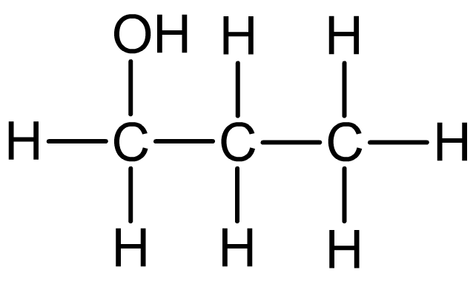
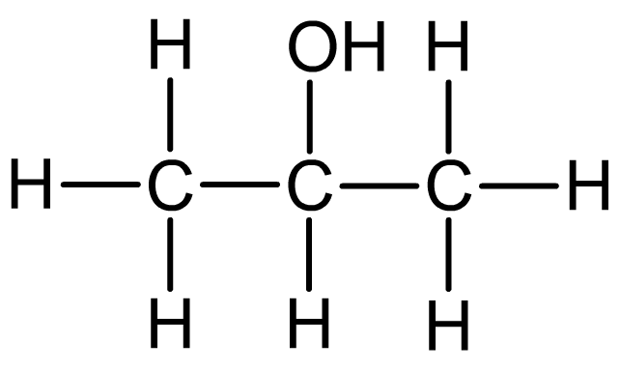
Naming alcohols
Alcohols with three or more carbon atoms display positional isomerism. The number of the carbon to which the hydroxyl groups is attached is written before the –ol.
propan-1-ol
propan-2-ol

Slide 6
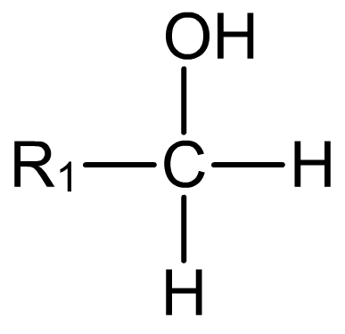
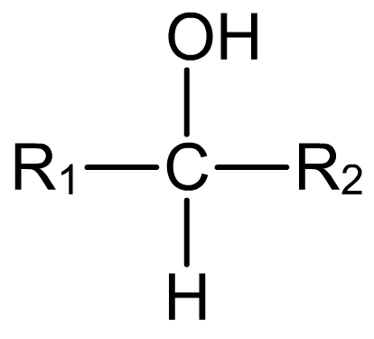
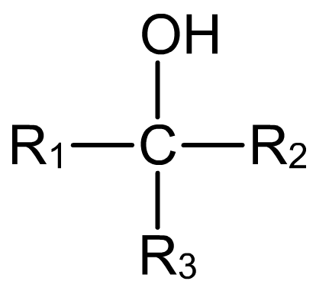
Primary, secondary and tertiary
What do you think this means?
A chain of carbon atoms can be represented by R when drawing the structure. This is referred to as an R group.
Primary (1°) alcohols have one R group attached to the carbon to which the OH group is attached.
Secondary (2°) alcohols have two R groups attached to the carbon to which the OH group is attached.
Tertiary (3°) alcohols have three R groups attached to the carbon to which the OH group is attached.

Slide 7
Alcohols
Objective: To know about alcohols
Outcomes:
know that alcohols can be classified as primary, secondary or tertiary
understand the reactions of alcohols with halogenating agents: - PCl₅ to produce chloroalkanes - 50% concentrated sulfuric acid and potassium bromide to produce bromoalkanes - red phosphorus and iodine to produce iodoalkanes
understand the reactions of alcohols with concentrated phosphoric acid to form alkenes by elimination
In equations, the oxidising agent can be represented as [O].
Descriptions of the mechanisms of these reactions are not expected.

Slide 8
Forming chloroalkanes from alcohols
Primary, secondary and tertiary alcohols all react with phosphorus(V) chloride to form a chloroalkane.
ROH + PCl₅ → RCl + HCl + POCl₃
CH₃CH₂OH + PCl₅ → CH₃CH₂Cl + POCl₃ + HCl
Adding solid phosphorous(V) chloride to an alcohol at room temperature produces white HCl fumes, as well as the chloroalkane.
This reaction can be used as a test for alcohols (the OH group), as well as a method of producing halogenoalkanes.
Notes:
Teacher notes
Phosphorus(III) chloride can also be used a sa chlorinating agents. Phosphorus(V) chloride is a solid, and the reaction with alcohols can take place at room temperature. Phosphorus(III) chloride is a liquid, and must be refluxed with an alcohol for chlorination to take place.
Both carboxylic acids and water also react with phosphorus(V) chloride, so a test liquid should first be checked to see whether it is neutral or contains water.

Slide 9
You can also make chloroalkanes by reacting alcohols with hydrochloric acid.
ROH + HCl → RCl + H₂O
(CH₃)₃COH + HCl → (CH₃)₃CCl + H₂O
This reaction is fastest with tertiary alcohols and slowest with primary alcohols

Slide 10
Alcohols
Objective: To know about alcohols
Outcomes:
know that alcohols can be classified as primary, secondary or tertiary
understand the reactions of alcohols with halogenating agents: - PCl₅ to produce chloroalkanes - 50% concentrated sulfuric acid and potassium bromide to produce bromoalkanes - red phosphorus and iodine to produce iodoalkanes
understand the reactions of alcohols with concentrated phosphoric acid to form alkenes by elimination
In equations, the oxidising agent can be represented as [O].
Descriptions of the mechanisms of these reactions are not expected.

Slide 11
Making bromoalkanes from alcohols
Alcohols will react with compounds containing bromide ions (e.g. KBr) in a substitution reaction.
The hydroxyl group (-OH) is replaced by the bromide, so the alcohol is transformed into a bromoalkane.
The reaction uses an acid catalyst, e.g. 50% conc H₂SO₄

Slide 12
Making bromoalkanes from alcohols
Example page 94

Slide 13
Alcohols
Objective: To know about alcohols
Outcomes:
know that alcohols can be classified as primary, secondary or tertiary
understand the reactions of alcohols with halogenating agents: - PCl₅ to produce chloroalkanes - 50% concentrated sulfuric acid and potassium bromide to produce bromoalkanes - red phosphorus and iodine to produce iodoalkanes
understand the reactions of alcohols with concentrated phosphoric acid to form alkenes by elimination
In equations, the oxidising agent can be represented as [O].
Descriptions of the mechanisms of these reactions are not expected.

Slide 14
Making iodoalkanes using red phosphorous and iodine
If you react an alcohol with phosphorous triiodide (PI₃) you make an iodoalkane
PI₃ is usually made in situ (within the reaction mixture by refluxing the alcohol with red phosphorous and iodine
3ROH + PI₃ → 3RI + H₃PO₃

Slide 15
Alcohols
Objective: To know about alcohols
Outcomes:
know that alcohols can be classified as primary, secondary or tertiary
understand the reactions of alcohols with halogenating agents: - PCl₅ to produce chloroalkanes - 50% concentrated sulfuric acid and potassium bromide to produce bromoalkanes - red phosphorus and iodine to produce iodoalkanes
understand the reactions of alcohols with concentrated phosphoric acid to form alkenes by elimination
In equations, the oxidising agent can be represented as [O].
Descriptions of the mechanisms of these reactions are not expected.

Slide 16
Alcohols can be dehydrated to form alkenes
You can make alkenes by eliminating water from alcohols in elimination reactions
The alcohol is mixed with an acid catalyst such as con phosphoric acid (H₃PO₄)
The mixture is then heated
The water is eliminated
C₂H₅OH → CH₂ = CH₂ + H₂O
The water molecule is made up from the hydroxyl group and a hydrogen atom that was bonded to a carbon atom adjacent to the hydroxyl group

Slide 17
Alcohols can be dehydrated to form alkenes
The water molecule is made up from the hydroxyl group and a hydrogen atom that was bonded to a carbon atom adjacent to the hydroxyl group
This means that often there are two possible alkene products from one elimination reaction depending on which side of the hydroxyl group the hydrogen is eliminated from
Also the alkene products may be able to from E/Z isomers. If they can a mixture of both isomers will be made

Slide 18
Alcohols can be dehydrated to form alkenes
Example page 95

Slide 19
Alcohols
Objective: To know about alcohols
Outcomes:
know that alcohols can be classified as primary, secondary or tertiary
understand the reactions of alcohols with halogenating agents: - PCl₅ to produce chloroalkanes - 50% concentrated sulfuric acid and potassium bromide to produce bromoalkanes - red phosphorus and iodine to produce iodoalkanes
understand the reactions of alcohols with concentrated phosphoric acid to form alkenes by elimination
In equations, the oxidising agent can be represented as [O].
Descriptions of the mechanisms of these reactions are not expected.

Slide 20
Alcohols Questions
Draw and name a primary alcohol, a secondary alcohol and a tertiary alcohol each with the formula C₅H₁₂O
Describe how ethanol could be converted into bromoethane
When 3-methyl-pentan-3-ol is heated with concentrated phosphoric acid it reacts to form a mixture of organic products a) What is the name of this type of reaction? b) How many organic compounds will be produced?
A 4 B 3 C 2 D 1
4. Iodoalkanes can be prepared from alcohols.
State the two inorganic reagents needed to produce iodoalkanes from alcohols
The mixture of reagents in part (a) produces phosphorous (III) iodide. Write an equation to represent the reaction between this and propan-1-ol.
Notes:
Pg 96 CPG 1 - 3

Slide 21
Alcohols Questions
Draw and name a primary alcohol, a secondary alcohol and a tertiary alcohol each with the formula C₅H₁₂O
2. Describe how ethanol could be converted into bromoethane
E.g. React ethanol with sodium bromide (KBr) with a 50% concentrated sulfuric acid catalyst.

Slide 22
Alcohols Questions
3. When 3-methyl-pentan-3-ol is heated with concentrated phosphoric acid it reacts to form a mixture of organic products a) What is the name of this type of reaction?
Elimination reaction or dehydration reaction
b) How many organic compounds will be produced?
A 4 B 3 C 2 D 1

Slide 23
Alcohols Questions
4. Iodoalkanes can be prepared from alcohols.
State the two inorganic reagents needed to produce iodoalkanes from alcohols
Red phosphorus and iodine
b) The mixture of reagents in part (a) produces phosphorous (III) iodide. Write an equation to represent the reaction between this and propan-1-ol.
3CH₃CH₂CH₂OH + PI₃ → 3CH₃CH₂CH₂I + H₃PO₃
Notes:
From Edexcel workbook (pg 91????)

Slide 24
Alcohols
Objective: To know about alcohols
Outcomes:
know that alcohols can be classified as primary, secondary or tertiary
understand the reactions of alcohols with halogenating agents: - PCl₅ to produce chloroalkanes - 50% concentrated sulfuric acid and potassium bromide to produce bromoalkanes - red phosphorus and iodine to produce iodoalkanes
understand the reactions of alcohols with concentrated phosphoric acid to form alkenes by elimination
In equations, the oxidising agent can be represented as [O].
Descriptions of the mechanisms of these reactions are not expected.

