Slide 1
Topic 5: Formulae, Equations and Amount of Substance Lesson 1 Moles

Slide 2
Why is this a special day special in Chemistry?
October 23 from 6:02 a.m. to 6:02 p.m

Slide 3
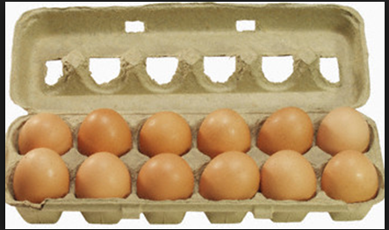
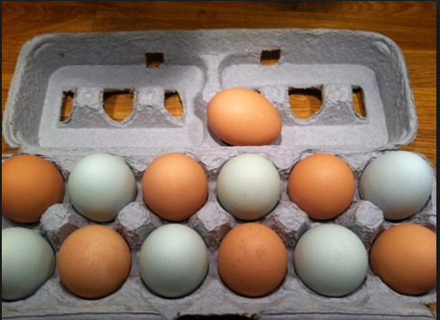
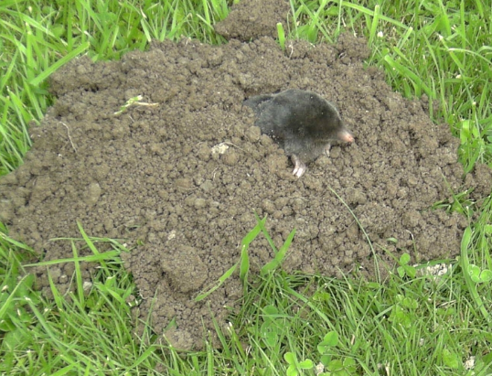
Say anything you can about each of the pictures below.
Mole = 602000000000000000000000000
Notes:
Pony = £25 bullseye= £50

Slide 4
Moles
Objective:
To know about moles and how to calculate the number of moles
Outcomes:
know that the mole (mol) is the unit for amount of a substance
be able to use the Avogadro constant, L, (6.02 × 10²³ mol⁻¹) in calculations
know that the molar mass of a substance is the mass per mole of the substance in g mol⁻¹
To be able to use and rearrange the formula: moles = mass of substance / molecular mass

Slide 5
Formula
What does a formula tell us: H₂O
The number of atoms of each element in the compound.
So water is made up of two hydrogen atoms and one oxygen atom:

Slide 6
Water
The M_{r} of water is 18.
This is made up of
2x H atom weighing 1 each for a total of 2
1x O atom weighing 16
So in water the ratio of oxygen:hydrogen is:
16:2

Slide 7
16:2
This means that a sample of 18g of water is made up of:
16g of oxygen, 2g of hydrogen
A sample of 18 tonnes of water is made up of:
16 tonnes of oxygen, 2 tonnes of hydrogen
So 32 kg of water is made up of?
32 kg of oxygen, 4 kg of hydrogen.

Slide 8
Formula revision
Calculate the molecular mass of the following formula:

Slide 9
Moles and Amount of Substance
Amount of substance means the number of particles.
It is measured using a unit called mole (mol), symbol n.
The number of particles in one mole is 6.02 x 10²³
This is Avogadro’s constant, symbol L
It has the unit mol⁻¹
It doesn’t matter what the particles are you always have that number.
It can be atoms, ions, molecules, Lego bricks, cats. Anything at all.

Slide 10
Avogadro’s constant
Modern day chemists know how many particles of a substance are present in one mole:
602,000,000,000,000,000,000,000!
That’s enough drinks cans to cover the surface of the Earth…..
…..300km deep!!!

Slide 11
Moles
Number of moles = Number of particles you have
Number of particles in a mole
You have to specify the chemical species when calculating the amount of substance or number of particles.
For example if we have hydrogen what particles do we have?
Why is it important?
2 g of hydrogen contains 2 mol of H atoms (12.04 x 10²³ atoms) but only 1 mol of H₂ molecules (6.02 x 10²³ molecules)

Slide 12
Molar Mass
Molar mass, M, is the mass of one mole of a chemical – the unit is g mol⁻¹.
So it’s the same as the relative molecular mass, M_{r} , with g mol⁻¹ at the end

Slide 13
Important formula!
This formula is really important, you will use it all the time in chemistry throughout all the different topics.
Number of moles = mass of substance
molar mass

Slide 14
What mass of substance do we have?
Mass of substance = number of moles x M
E.g 2 mols of water = 2 x 18 = 36g
Complete question 1 (page 11)

Slide 15
What amount of substance do we have?
Moles are a measure of the amount of substance.
Amount of substance = mass M
E.g 18g of water = 18 = 1 mol 18
Complete question 2 on page 11

Slide 16
Questions
Starters for 10 section 1
Past exam questions
AQA questions

Slide 17
Units
Mass
Measured in g (SI unit is kg)
Volume
Measured in cm³ or dm³
(1dm³ = 1000cm³ = 1 litre)
Amount of substance
Measured in moles
Abbreviated to mols
These specific terms are used in exam questions, make sure you are answering the right question and use the right units!

Slide 18
Moles
Objective:
To know about moles and how to calculate the number of moles
Outcomes:
know that the mole (mol) is the unit for amount of a substance
be able to use the Avogadro constant, L, (6.02 × 10²³ mol⁻¹) in calculations
know that the molar mass of a substance is the mass per mole of the substance in g mol⁻¹
To be able to use and rearrange the formula: moles = mass of substance / molecular mass

