Slide 1
The boiling points of alkanes and alcohols

Slide 2
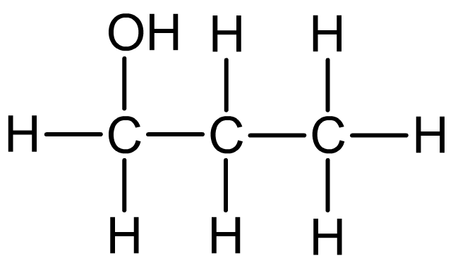
Boiling points
Ethane = - 82ºC
Ethanol = 78ºC
Propane = -42ºC
Propanol = 97ºC
What do you notice?
Can you explain why?
Alcohols can form hydrogen bonds as they do have a polar O-H bond. This means that they have higher boiling points than their equivalent alkanes (which don’t form hydrogen bonds).
The hydrogen bonding explains the relatively low volatility (higher boiling temperatures) of alcohols compared to alkanes with a similar number of electrons.
Alcohols contain an O-H group

Slide 3
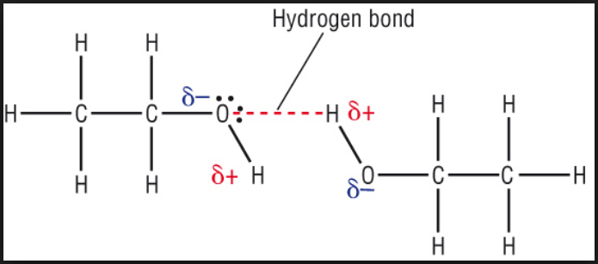
Alcohols can form hydrogen bonds as they do have a polar O-H bond. This means that they have higher boiling points than their equivalent alkanes (which don’t form hydrogen bonds).
The hydrogen bonding explains the relatively low volatility (higher boiling temperatures) of alcohols compared to alkanes with a similar number of electrons.

Slide 4
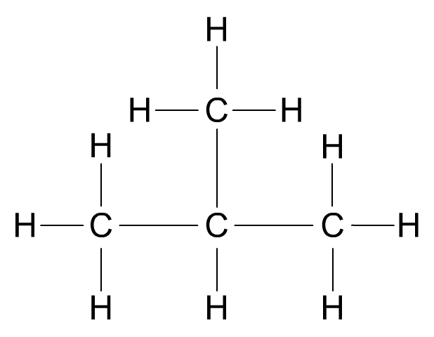
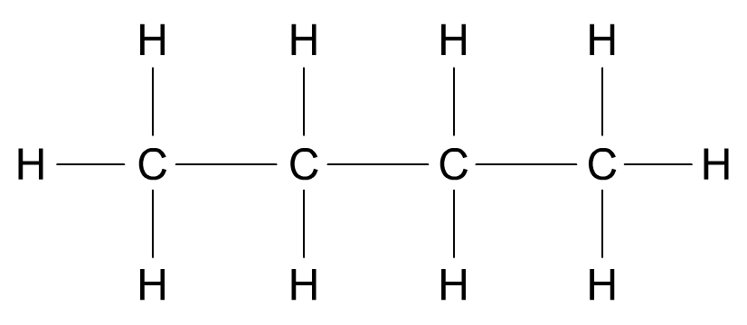
Strength of van der Waals forces
The points of contact between molecules also affects the strength of van der Waals forces.
butane (C₄H₁₀)
boiling point = 272 K
2-methylpropane (C₄H₁₀)
boiling point = 261 K
Straight chain alkanes can pack closer together than branched alkanes, creating more points of contact between molecules. This results in stronger van der Waals forces.

Slide 5
Use the data to draw graphs to see how branching effects the boiling points of alkanes.
What do you notice?
Can you explain your observations?

