Slide 1
What is an Electrochemical Cell?
Electrochemical cells:
Measure the relative reducing ability of different species
Lets you predict the direction of spontaneous change.
2 different metals
Dipped in salt solutions of their own ions
Connected by a wire (external circuit)
Salt bridge
High-resistance volt meter
E.g., Zinc/copper electrochemical cell
Notes:
Start to build up drawing Zn/Cu of elecrochemical cell
Salt bridge – allows ions to flow and balances out the charges
e- flow through the wire from the more reactive to the less reactive metal
A high-resistance voltmeter shows the voltage between the 2 half cells. Cell potential=cell EMF=Ecell

Slide 2
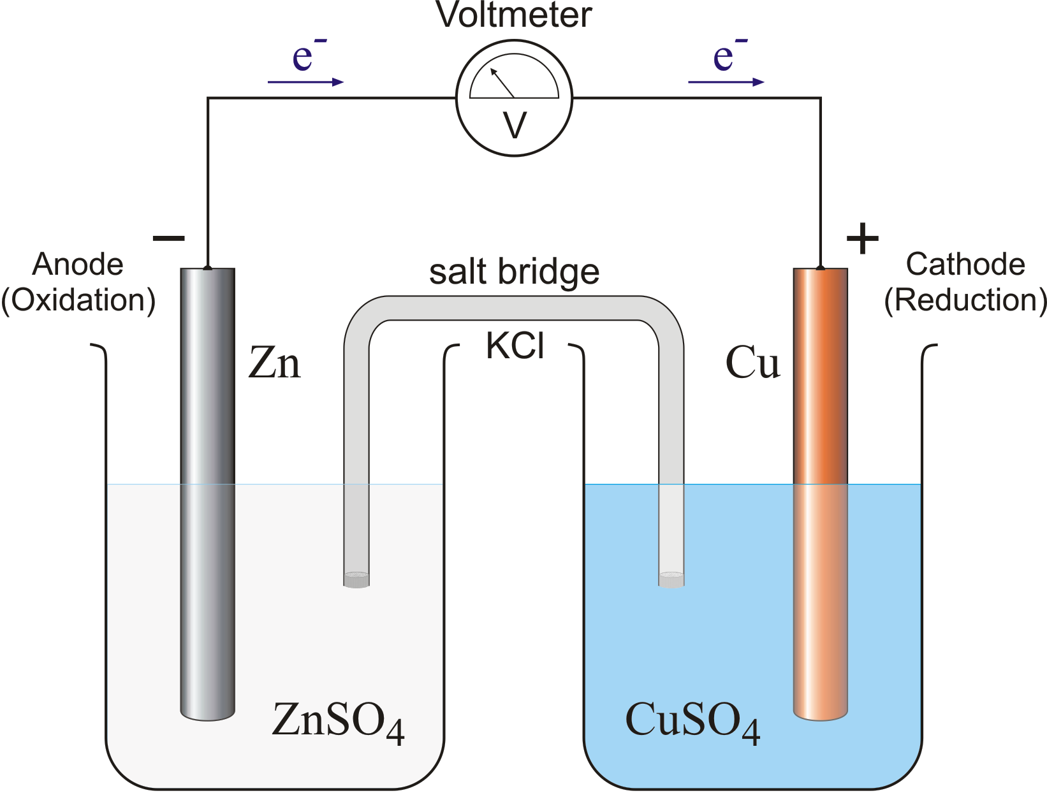
Do Now - Zinc/copper electrochemical cell
Write half equations for the reactions
Which is an oxidation reaction and which is reduction?
What has happened to the SO₄²⁻ ions?
Name the reducing agent.
Name the oxidising agent.
What is the overall equation?
Half equations:
Zn(s) → Zn²⁺(aq) + 2e-
Cu²⁺ (aq) + 2e- → Cu(s)
Oxidation
Reduction
Notes:
Draw Zn and Cu electrochemical cell
Zn loses e- more easily than copper
Zn ox to Zn 2+
Releases e- into external circuit
In the other half cell, the same of electrons are taken from the external circuit
Cu 2+ ions reduced to copper
Teacher demo of this reaction.
Zn (ox), Cu2+ (red)
Sufate ions are spectator ions and do not take part in the reaction
Zn reducing agent – they donate e-.
Cu2+ oxidising agent – they accept e-.
Nothing will happen if you attempt the reverse reaction. Copper is not sufficiently powerful reducing agent to reduce the Zn2+ to Zn.

Slide 3
A simple zinc half-cell
Zn²⁺(aq) + 2 e– ↔ Zn(s)
Notes:
A simple zinc half-cell

Slide 4
In this electrochemical cell, e- flow in the external circuit from left to right, giving a pd of +1.103V
The zinc electrode loses e- so the position of Eqm lies to the left.
Zn²⁺(aq) +2e- ↔ Zn
The copper electrode gains e- so the position of Eqm lies to the right.
Cu²⁺(aq) +2e- ↔ Cu
Notes:
In this electrochemical cell, e- flow in the external circuit from left to right, giving a pd of +1.103V
Overall: [Zn2+] increases and Cu is deposited. Just as in the redox equation reaction at the start.
BUT copper is deposited on the Cu electrode, not on Zn.

Slide 5
REDCAT
- electrode
anode
oxidation
+ electrode
cathode
reduction
electron flow
At this electrode the metal loses electrons and so is oxidised to metal ions.
These electrons make the electrode negative.
At this electrode the metal ions gain electrons and so is reduced to metal atoms.
As electrons are used up, this makes the electrode positive.
Zn
Cu
Zn → Zn²⁺ + 2 e⁻
oxidation
Cu²⁺ + 2 e⁻ → Cu
reduction
Notes:
REDCAT = reduction at the cathode
“reduction on the right”
“lowest on the left”
One particular area of difficulty is assigning the electrodes in an electrochemical cell, as the definition of anode and cathode seems to conflict with that learned at GCSE in electrolysis.
At GCSE students will have been taught that the cathode is negative, yet in an electrochemical cell the cathode is positive.
This problem arises because at GCSE the electrodes have been assigned based on polarity, and this is a fundamental mistake.
The electrodes in any electrochemical process are correctly assigned based on process and not polarity.
Thus, if we define the anode as the electrode where oxidation takes place, and the cathode as being where reduction takes place, the conflict disappears.
The incorrect approach to assigning anode and cathode based on polarity is unfortunately very common in text books and other otherwise reliable resources.

Slide 6
Representing Cells
Simple way to represent cells ...
Standard cell notation or cell diagram for zinc/copper cell.
Zn(s) I Zn²⁺(aq) II Cu²⁺(aq) ICu(s)
Single vertical line: Separates 2 phases (s, and aq)
Double vertical line: Salt bridge.
2 (aq) solutions are next to the salt bridge
2 single lines at each end
If a half-cell contains a mixture of aq ions, a comma is used to separate them
Fe(s) I Fe²⁺(aq), Fe³⁺(aq)
OIL RIG
R O O R

Slide 7
UNLESS TOLD IN THE QUESTION …
Reduction on the RIGHT
Lowest on the LEFT
OIL RIG
RO OR
Ni(s) | Ni²⁺(aq) || Sn⁴⁺(aq), Sn²⁺(aq) | Pt(s)
K(s) | K⁺(aq) || Mg²⁺(aq) | Mg(s)

Slide 8
Example
Magnesium and Copper
Mg: E°= -2.37V
Cu: E° = +0.34V
Which one will carry out oxidation?
Which one will carry out reduction?
What is the overall emf of the cell?
(Clue: E° _{cell} = E°_{right} - E°_{left})

Slide 9
Calculating emf (E^{θ}_{cell})
E^{θ}_{cell} = E^{θ}_{R} - E^{θ}_{L}
E^{θ}_{cell} = E^{θ}_{Reduced} - E^{θ}_{oxidised}
UNLESS TOLD IN THE QUESTION …
Reduction on the RIGHT
Lowest on the LEFT
(the most + goes in forward direction)
Zn²⁺ + 2 e⁻ ↔ Zn E° = -0.76
Cu²⁺ + 2 e⁻ ↔ Cu E° = +0.34
Zn + Cu²⁺ → Zn²⁺ + Cu
+ answers tells us that the reaction IS feasible
E^{θ}_{cell} = E^{θ}_{R} - E^{θ}_{L}
= +0.34 – (-0.76) = +1.10V
Notes:
Add in state symbols
What would happen if we tried to do the REVERSE? What would Ecell be? Would this be feasible?

Slide 10
Task
Electrochemistry Workbook Task 7 Q 1-7

Slide 11
ELECTRODE POTENTIALS – Q1
Emf = E°_{right} - E°_{left}
- 2.71 = E°_{right} - 0
E°_{right} = - 2.71 V

Slide 12
ELECTRODE POTENTIALS – Q2
Emf = E°_{right} - E°_{left}
Emf = - 0.44 - 0.22
Emf = - 0.66 V

Slide 13
ELECTRODE POTENTIALS – Q3
Emf = E°_{right} - Ev_{left}
Emf = - 0.13 - (-0.76)
Emf = + 0.63 V

Slide 14
ELECTRODE POTENTIALS – Q4
Emf = E°_{right} - E°_{left}
a) Emf = + 0.15 - (-0.25) = +0.40 V
b) Emf = + 0.80 - 0.54 = +0.26 V
c) Emf = + 1.07 - 1.36 = - 0.29 V

Slide 15
ELECTRODE POTENTIALS – Q5
Emf = E°_{right} - E°_{left}
+1.02 = +1.36 - E°_{left}
E°_{left} = + 1.36 - 1.02 = +0.34 V

Slide 16
ELECTRODE POTENTIALS – Q6
Emf = E°_{right} - E°_{left}
a) E°_{right} = +2.00 - 2.38 = - 0.38 V
Ti³⁺(aq) + e⁻ ↔ Ti²⁺(aq)
b) E°_{left} = -2.38 - 0.54 = - 2.92 V
K⁺(aq) + e⁻ ↔ K(aq)
c) E°_{right} = - 3.19 + 0.27 = - 2.92 V
Ti³⁺(aq) + e⁻ ↔ Ti²⁺(aq)

Slide 17
ELECTRODE POTENTIALS – Q7
a) Cr(s) | Cr²⁺(aq) || Zn²⁺(aq) | Zn(s)
Emf = -0.76 - (-0.91) = +0.15 V
b) Cu(s) |Cu²⁺(aq)|| Fe³⁺(aq),Fe²⁺(aq)| Pt(s)
Emf = +0.77 - 0.34 = +0.43 V
c) Pt(s) | Cl⁻(aq)| Cl₂(g) || MnO₄⁻(aq),H⁺(aq),Mn²⁺(aq)| Pt(s)
Emf = +1.51 – 1.36 = +0.15 V

Slide 18
Standard Electrode Potential Cell Diagrams
Standard hydrogen electrode is always written on the left-hand side.
Pt(s) I ½ H₂ (g) I H⁺ (aq) II Zn²⁺(aq) I Zn(s)
Pt(s) I ½ H₂ (g) I H⁺ (aq) II Cu²⁺(aq) I Cu(s)

Slide 19
Quick Check
a. Explain the functions in an electrochemical cell of a salt bridge and a high-resistance voltmeter.
b. Describe the electrochemical cell represented by:
Pt(s) I Fe²⁺(aq), Fe³⁺(aq) II Ag⁺(aq) I Ag(s)
Complete Questions on page 91 of textbook.

