Slide 1
Homework
Research different ways of measuring rates of reaction.
The following examples must be included:
Gas produced
Mass loss
Amount of product formed

Slide 2
AS Chemistry
Topic 9 Kinetics 1
Rates of reaction: Collision Theory
Sunday, 17 April 2016

Slide 3
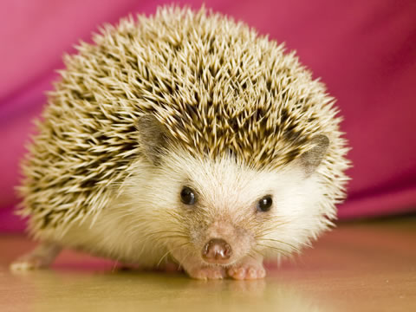
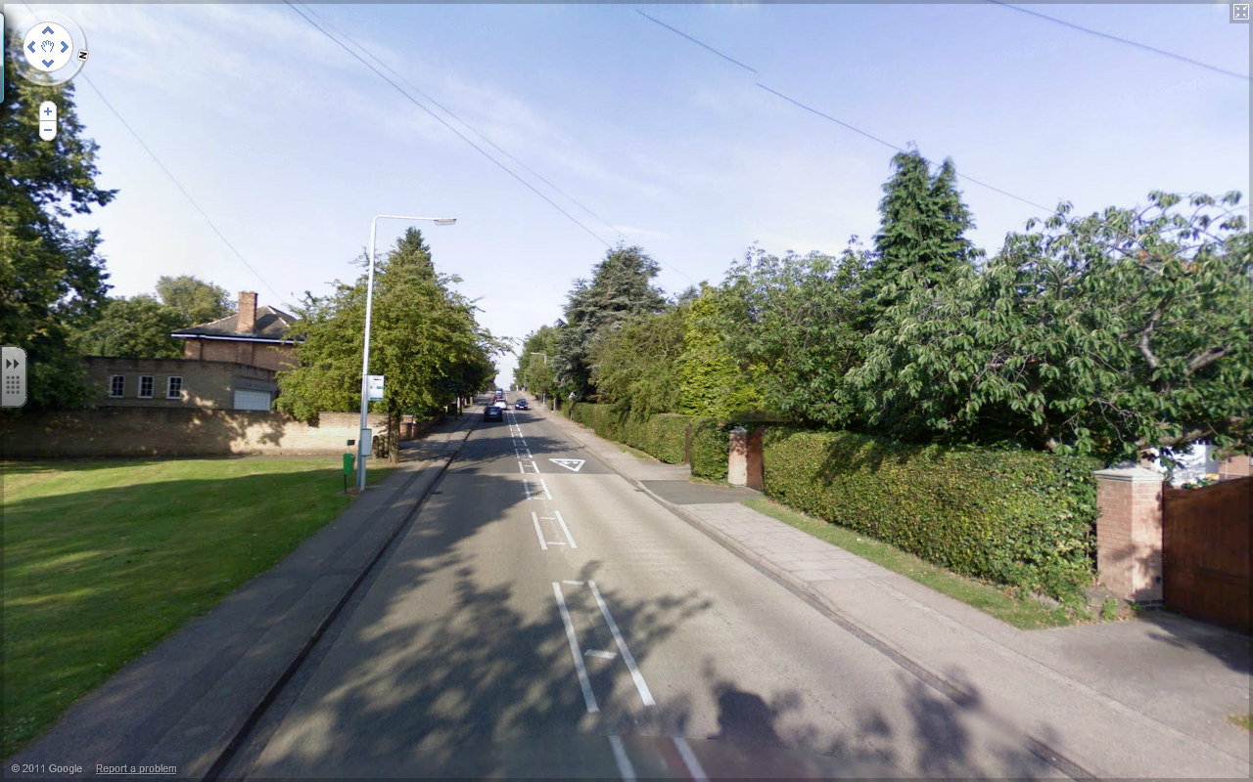
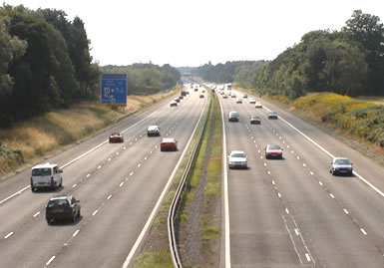
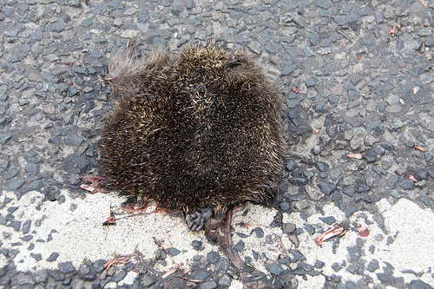
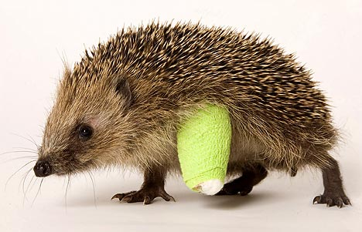
What is the difference between these 2 roads?
What is the difference between these 2 roads?
Which road should Sebastian cross & why?
Faster & More Cars
More cars
Moving faster
More chance of a collision & the collision has more energy
Notes:
Link to concentration and temperature

Slide 4
Collision Theory Objectives
understand, in terms of collision theory, the effect of a change in concentration, pressure and surface area on the rate of a chemical reaction
understand that reactions only take place when collisions take place with sufficient energy, known as activation energy
be able to calculate the rate of a reaction from:
i data showing the time taken for reaction
ii the gradient of a suitable graph, by drawing a tangent, either for initial rate, or at a time, t

Slide 5
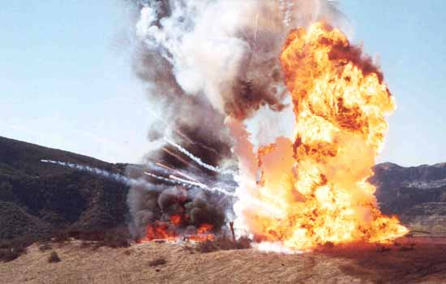
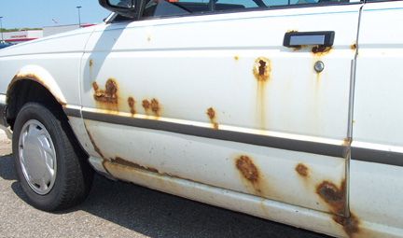
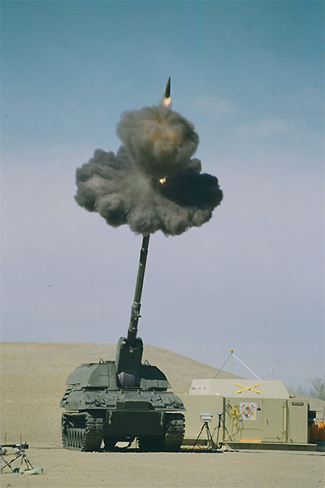
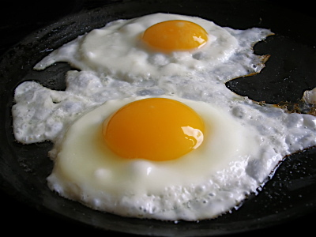
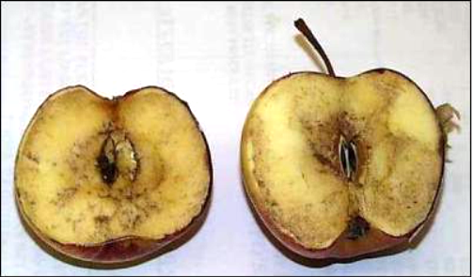
What’s different about these chemical reactions?

Slide 6
Factors which affect rate
Temperature
Concentration
Pressure
Surface area
Catalysts

Slide 7
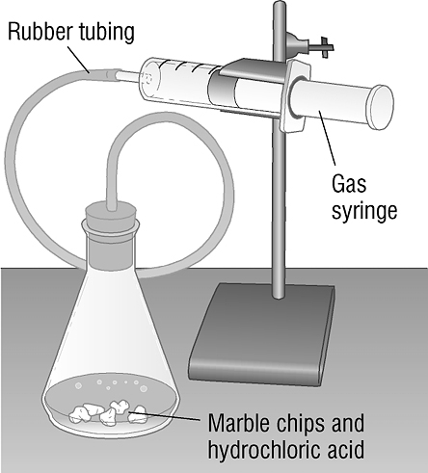
Rate of reaction practical
Put about five marble chips into the bottom of a conical flask.
Measure out 25 cm³ of acid using a measuring cylinder. Record the concentration of acid in one of the columns on the table.
Add the acid to the conical flask and quickly replace the bung that is connected to the gas syringe.
Start the stopwatch. Record in the table on the next page the volume of the gas every 10 seconds for 2 minutes.
Dispose of the solution and any remaining marble chips as directed by your teacher.
Repeat the experiment using different concentrations of acid. Record your results in the table.

Slide 8
 | Volume of gas given off (cm³)
Time (seconds) | Concentration of acid: | Concentration of acid: | Concentration of acid:
0
10
20
30
40
50
60
70
80
90
100
110
120

Slide 9
Practical – Precipitation reaction
Measure how quickly the product is formed. The solution turns cloudy. The quicker it turns cloudy the faster the rate of reaction. You record how long it takes before you can’t see the X.

Slide 10
The effect of temperature on rate
Notes:
Teacher notes
This animation can be used to introduce the reaction between sodium thiosulfate and hydrochloric acid as a way of measuring the effect of temperature on rate of reaction. It could be shown as precursor to running the experiment in the lab, or as a revision exercise.

Slide 11
Nuffield practical 11.4 page 256
Follow instructions
Draw a graph like it tells to you to

Slide 12
Results
What did we find out?
How do your results show this?

Slide 13
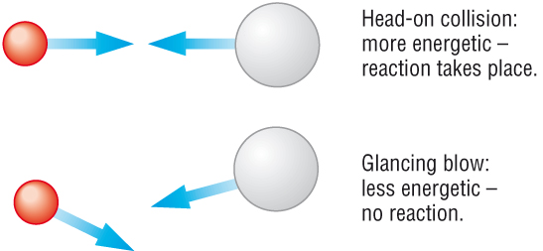
Collision Theory
Collision theory states that for two molecules to react they must first physically collide.
However they will only react if they have enough energy to overcome the E_{a}:
This will depend on the speed of the molecules (temperature) as well as the direction of their impact

Slide 14
In order to react two reagents need to collide with enough energy
The minimum energy they need to react is
called the activation energy.

Slide 15
Collision Theory
The molecules will also need to be in the right orientation:

Slide 16
Rate of Reaction
Rate of reaction = change in recorded property
time taken for the change
E.g.
Rate =
Units =
Volume of gas collected
Time taken
mol.dm⁻³
=
mol.dm⁻³.s⁻¹
s

Slide 17
Reaction Rates
Does a reaction have the same rate from beginning to end?
No!
The concentration of reactants is highest at the beginning.
However during the reaction they are used up.
So concentration of the reactants reduces, meaning that reaction rate decreases.

Slide 18
Rate of reaction graphs
All product
reactants
Amount of product
Mix of reactant
And product
product
Reactant Concentration falls
Rate of Reaction falls
Gradient of graph decreases
All reactant
Time
Notes:
Reactions do not proceed at a steady rate.
They start fast and get slower and slower.
This is not surprising because the reactant concentration (and the chance of collision) gets lower and lower as time progresses.

Slide 19
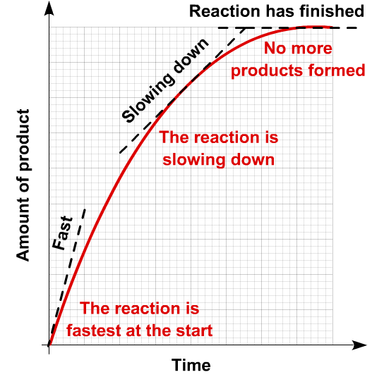
Calculating rate of reaction from a graph
Notes:
Page 14 text book

Slide 20
Collision Theory Objectives
understand, in terms of collision theory, the effect of a change in concentration, pressure and surface area on the rate of a chemical reaction
understand that reactions only take place when collisions take place with sufficient energy, known as activation energy
be able to calculate the rate of a reaction from:
i data showing the time taken for reaction
ii the gradient of a suitable graph, by drawing a tangent, either for initial rate, or at a time, t

Slide 21
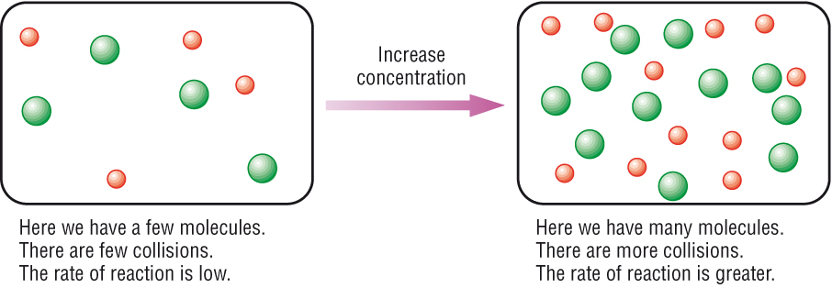
The effect of concentration
When we increase concentration, reaction rate increases. Why?
Increased concentration means more molecules in the same space.
Increasing concentration means that collisions are more frequent (more collisions in a certain amount of time)
So reaction rate increases.

Slide 22
Key words
We say the collisions are more frequent
This means that there are more collisions in a certain amount of time
So for a particular length of time more collisions will take place and there will be more collisions with energy greater than the activation energy.
Collisions will be more frequent and the rate of reaction will increase

Slide 23
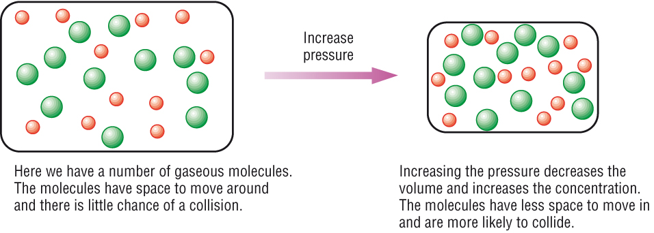
The Effect of Pressure
When we increase pressure, reaction rate increases. Why?
Pressure is just like concentration, but for gases.
Increasing pressure means that collisions are more frequent so reaction rate increases.

Slide 24
Altering the surface area
Large Surface Area
Small Surface Area

Slide 25
Surface area and particle collisions
Notes:
Teacher notes
This simulation illustrates how increasing the surface area increases the number of collisions between particles and solid reactants

Slide 26
Reducing the size of particles increases the rate of a reaction because it increases the surface area available for collisions to take place.
Increasing the number of collisions per second increases the rate of reaction.
This will then mean there is a greater chance of successful collisions

Slide 27
Collision Theory Objectives
understand, in terms of collision theory, the effect of a change in concentration, pressure and surface area on the rate of a chemical reaction
understand that reactions only take place when collisions take place with sufficient energy, known as activation energy
be able to calculate the rate of a reaction from:
i data showing the time taken for reaction
ii the gradient of a suitable graph, by drawing a tangent, either for initial rate, or at a time, t

Slide 28
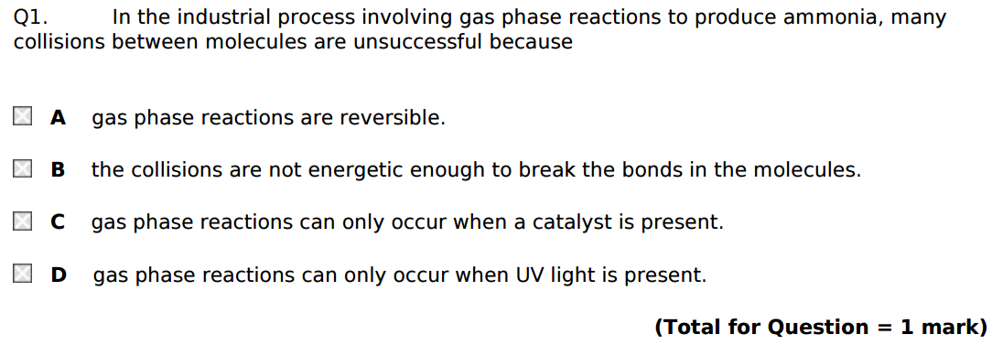
Exam Questions
Notes:
edexel

Slide 29
Notes:
Edexce;

Slide 30
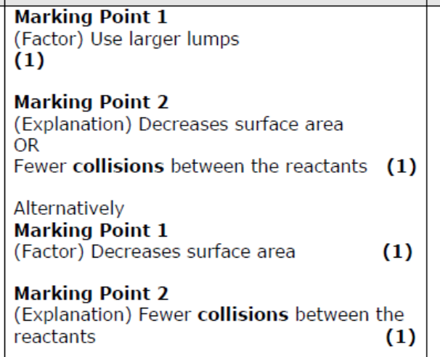
Answers

Slide 31
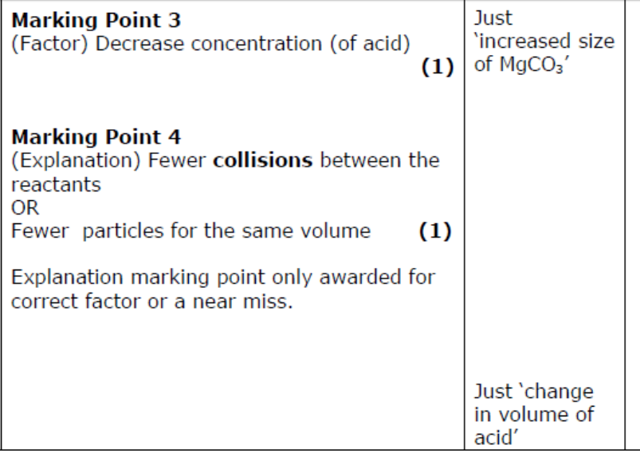
Reject

Slide 33
Collision Theory Objectives
understand, in terms of collision theory, the effect of a change in concentration, pressure and surface area on the rate of a chemical reaction
understand that reactions only take place when collisions take place with sufficient energy, known as activation energy
be able to calculate the rate of a reaction from:
i data showing the time taken for reaction
ii the gradient of a suitable graph, by drawing a tangent, either for initial rate, or at a time, t

Slide 34
Practical – Precipitation reaction
Measure how quickly the product is formed. The solution turns cloudy. The quicker it turns cloudy the faster the rate of reaction. You record how long it takes before you can’t see the X.

Slide 35
The effect of temperature on rate
Notes:
Teacher notes
This animation can be used to introduce the reaction between sodium thiosulfate and hydrochloric acid as a way of measuring the effect of temperature on rate of reaction. It could be shown as precursor to running the experiment in the lab, or as a revision exercise.

Slide 36
Measuring the volume of gas given off.
Notes:
Record how fast product is produced.

Slide 37
Measuring gases in reactions

Slide 38
Measuring gas in reactions

Slide 39
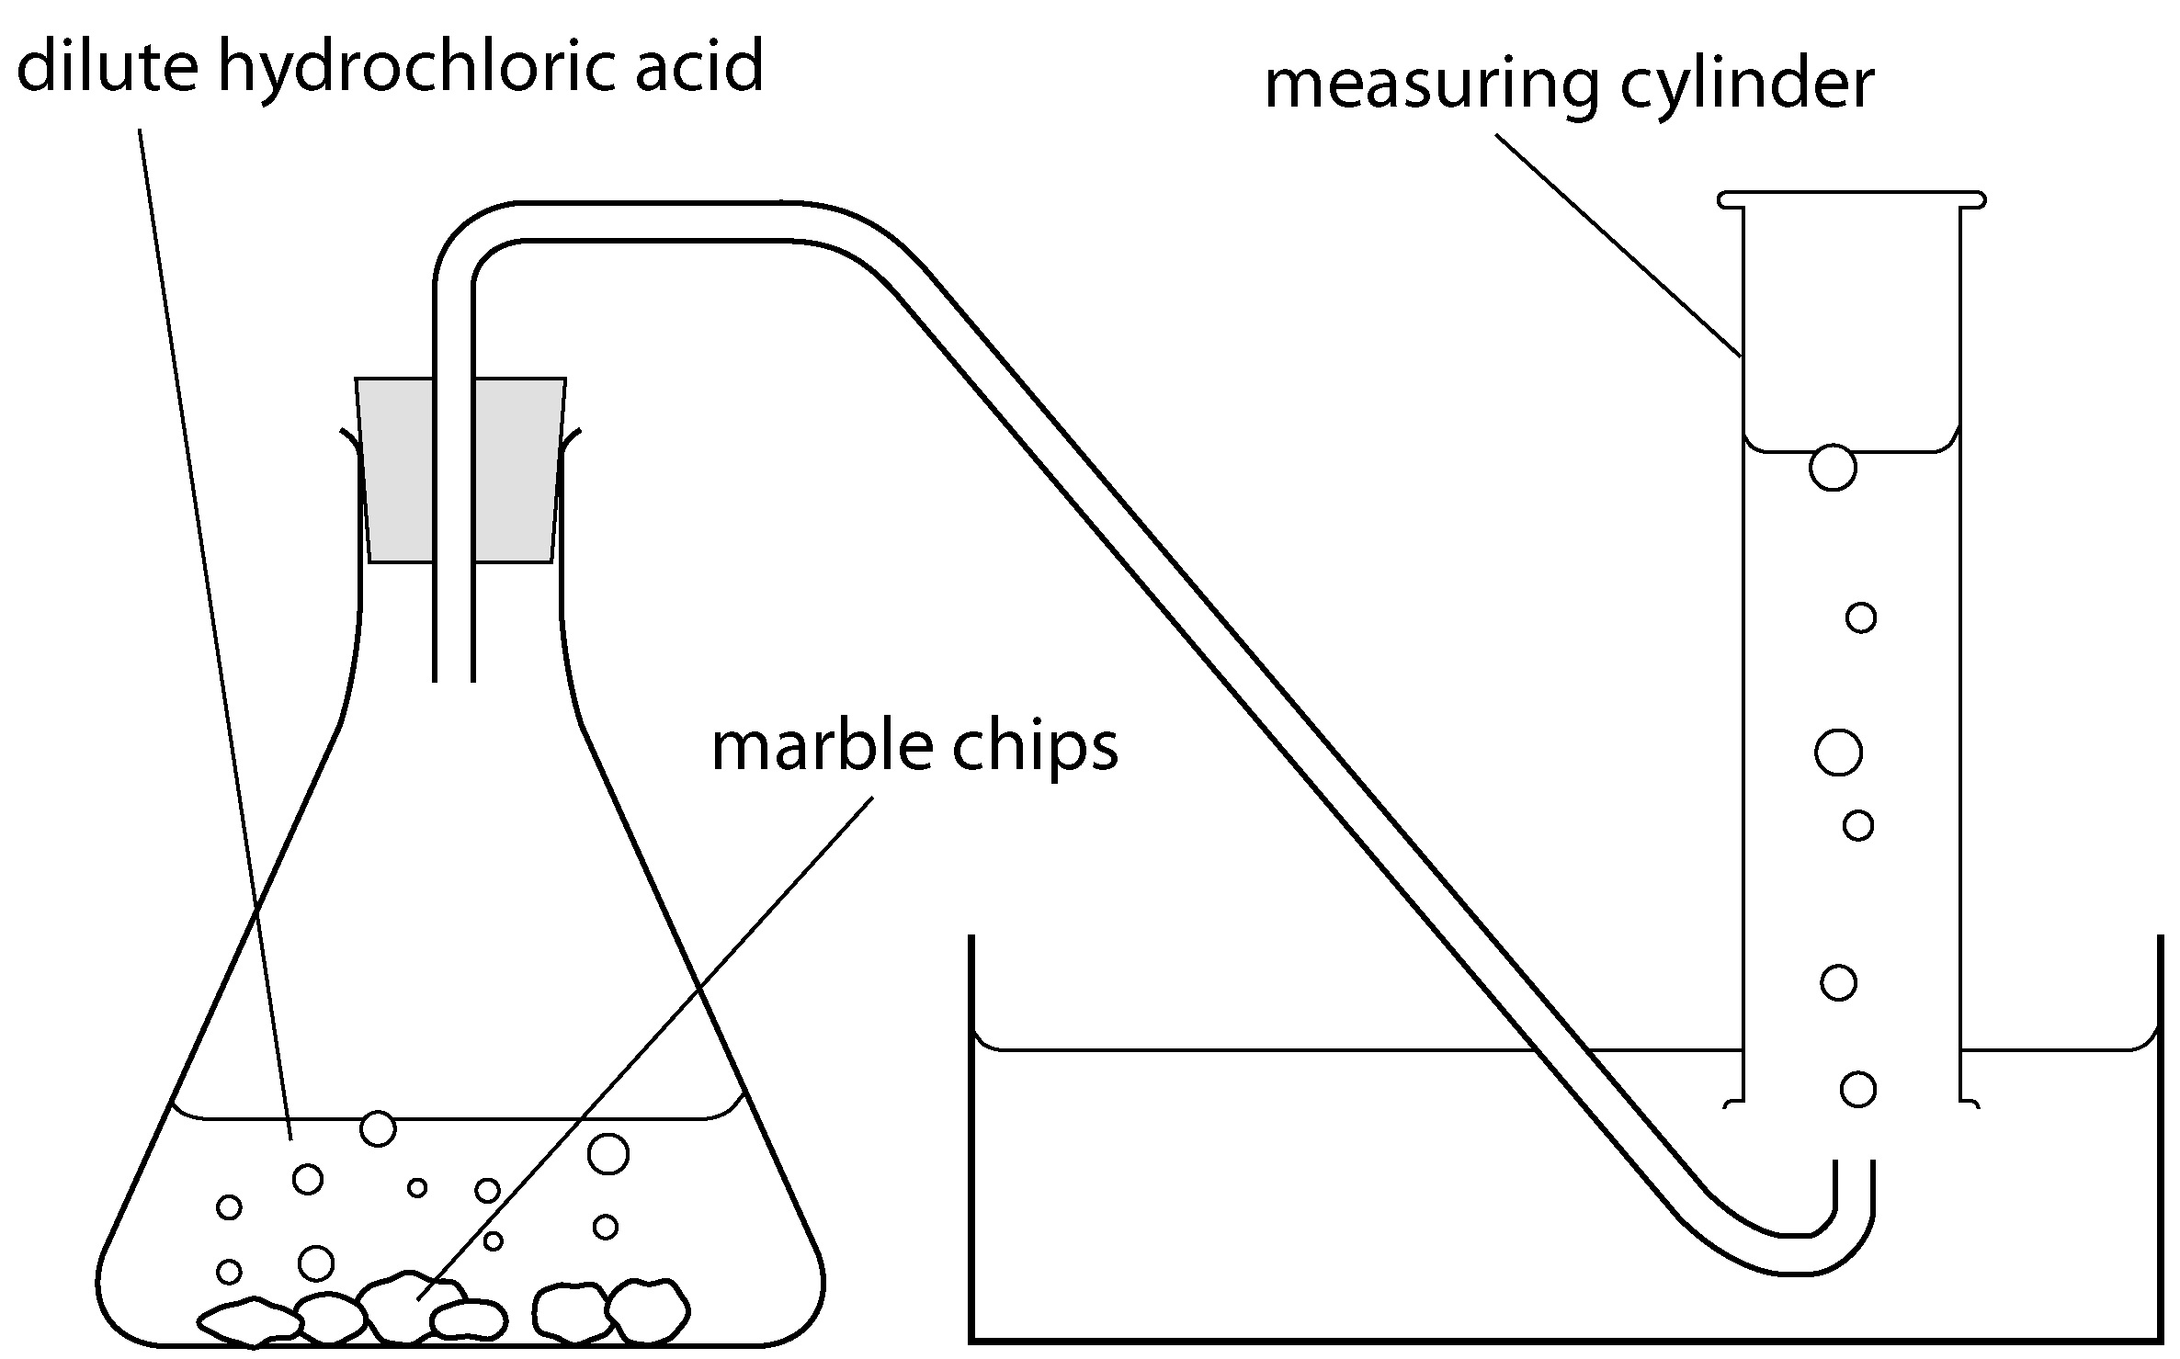
Measuring volume of gas produced
Which method is better?
Why?

Slide 40
Measuring the mass lost from a reaction.
Notes:
One of the products is a gas which is released into the atmosphere. Cotton wool used to stop liquid been lost

Slide 41
Reaction of marble chips with hydrochloric acid

