Slide 1
Do Now - Can you match the common name to the chemical name?
Chemical Name | Common Name
1. Methanoic acid | A. Butyric acid
2. Ethanoic acid | B. Benzoic acid
3. Propanoic acid | C. Isobutyric acid
4. Butanoic acid | D. Formic acid
5. Methylpropanoic acid | E. Acetic acid
6. Ethanedioic acid | F. Propionic acid
7. Benzenecarboxylic acid | G. Oxalic
Write out the structural formula for each of the carboxylic acids

Slide 2
Do Now - Can you match the common name to the chemical name?
Chemical Name | Common Name
1. Methanoic acid | A. Butyric acid
2. Ethanoic acid | B. Benzoic acid
3. Propanoic acid | C. Isobutyric acid
4. Butanoic acid | D. Formic acid
5. Methylpropanoic acid | E. Acetic acid
6. Ethanedioic acid | F. Propionic acid
7. Benzenecarboxylic acid | G. Oxalic

Slide 3
Carboxylic acids and their physical properties
Identify the carboxylic acid functional group
Understand that hydrogen bonding affects the physical properties of carboxylic acids, in relation to their boiling temperatures and solubility

Slide 4
Carboxylic Acids
The properties of carboxylic acids are due to the presence of the functional group -COOH
O
H
C
O
H
Methanoic Acid, HCOOH
C_{n}H_{2n+1}COOH

Slide 5
Carboxylic Acids
The properties of carboxylic acids are due to the presence of the functional group -COOH
O
H
C
O
H
Methanoic Acid, HCOOH
C_{n}H_{2n+1}COOH

Slide 6
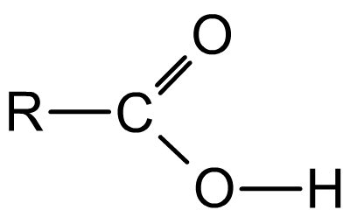
What reactions can take place with COOH?
May be attacked by positively charged species (like H⁺)
δ-
δ+
δ-
δ+
May be lost as H+ so compound behaves as an acid
Open to attack from nucleophiles

Slide 7
Reactivity of carboxylic acids
The reactivity of carboxylic acids results, in part, from the polarization of its bonds.
δ-
δ+
δ-
δ+
The reactions of carboxylic acids include:
neutralisation – the carboxylic acid loses a proton to form a carboxylate salt
nucleophilic substitution – the positively-charged carbon is attacked by a nucleophile, resulting in substitution of the OH group
esterification – reaction with an alcohol to form an ester.
Notes:
Teacher notes
Carboxylic acids will also react with reactive metals to produce the metal salt and hydrogen gas. Students could be asked to write balanced equations for a couple of these reactions, e.g. ethanoic acid + sodium, propanoic aid + magnesium.
See the ‘Acyl Compounds’ presentation for more information about esterification.

Slide 8
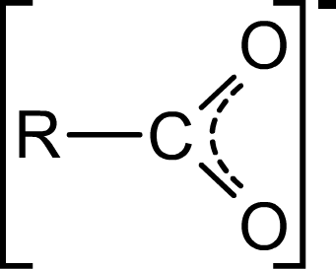
Forming the carboxylate ion
carboxylate ion
The negative charge is delocalized across the carboxylate group, resulting in a more stable ion. The delocalization is represented by adding a second dotted line to the carbon oxygen bonds, which are both equivalent.
Notes:
Dissociation in chemistry and biochemistry is a general process in which molecules (or ionic compounds such as salts, or complexes) separate or split into smaller particles such as atoms, ions or radicals, usually in a reversible manner

Slide 9
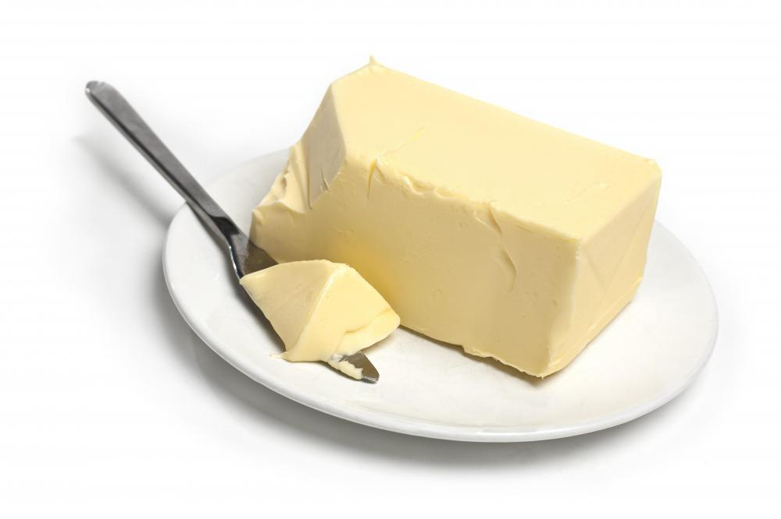
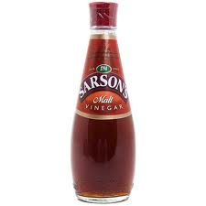
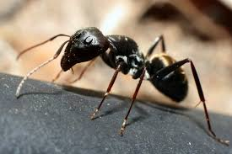
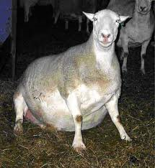
Methanoic acid found in ants and nettle stings
Ethanoic acid
Butanoic acid smells of rancid butter OR stale sweat
Hexanoic and octanoic acids found in goat fat and smell bad!!!

Slide 10
Predict
Which has the highest boiling point and why?
Propanal
Propane
Propanoic acid
Propan-1-ol

Slide 11
Boiling points of carboxylic acids

Slide 12
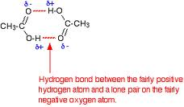
Draw a dimer (double molecule) of ethanoic acid, showing the hydrogen bonding between the two molecules

Slide 13
Can carboxylic acids dissolve in water and why?

Slide 14
Only up to C₄ (butanoic acid) though!

