Slide 1
Do Now
What is a carbonyl group?
Name the functional groups that contain a carbonyl group
Which of these functional groups are classified as carbonyl compounds?
What is the general formula for these carbonyl compounds?

Slide 2
Learning Outcomes
Identify the aldehyde and ketone functional group
Understand that aldehydes and ketones
Do not form intermolecular hydrogen bonds and this affects their physical properties
Can form hydrogen bonds with water, and this affects their solubility

Slide 3
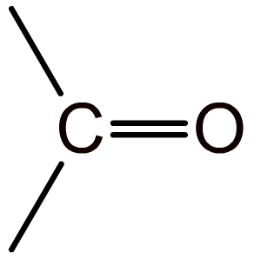
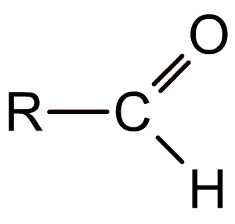
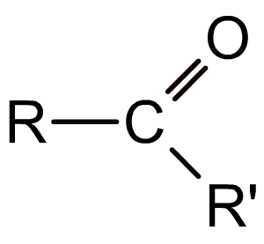
The carbonyl group
The carbonyl group (>C=O) is the functional group found in compounds such as aldehydes, ketones, esters and carboxylic acids.
In aldehydes the carbonyl group is at the end of the carbon chain and so has at least one hydrogen attached to it.
In ketones the carbonyl group is in the middle of a carbon chain and so has two alkyl groups attached to it.
The R groups can be ALKYL groups or ARYL groups
Notes:
Teacher notes
It could be pointed out to students that the carbonyl group is sometimes orientated differently in different displayed formulae (compare the top diagram with the bottom two) and that they should take care when identifying such structures.

Slide 4
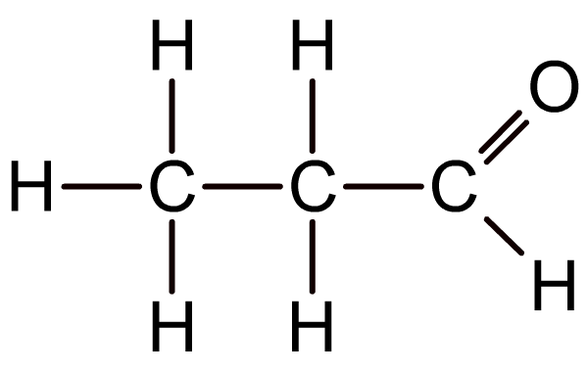
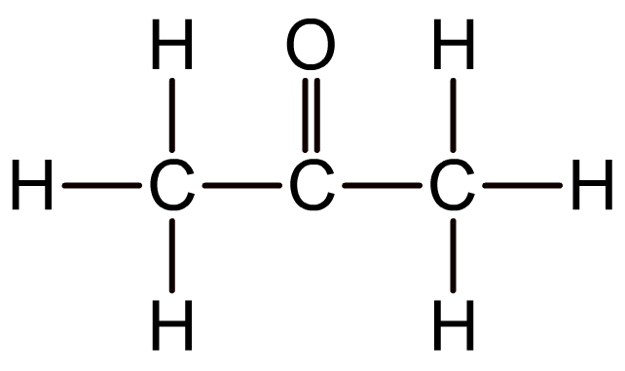
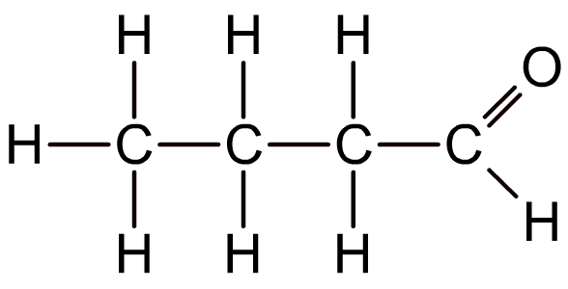
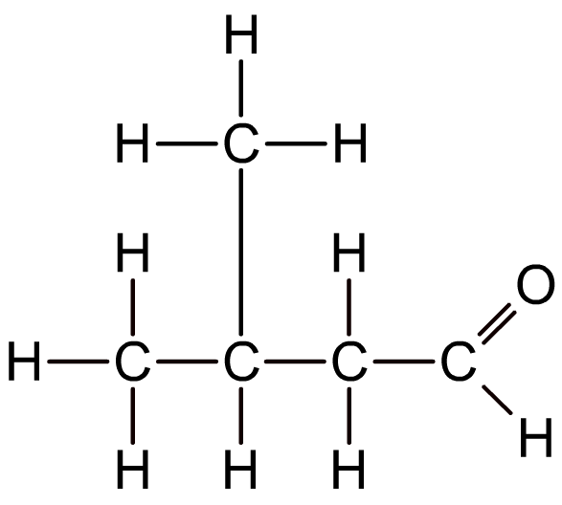
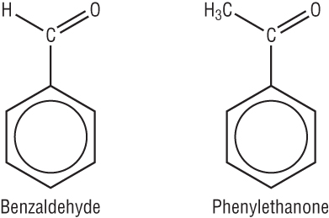
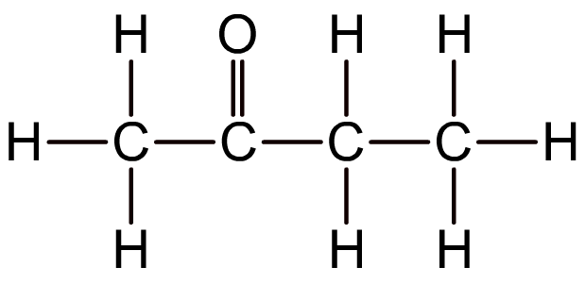
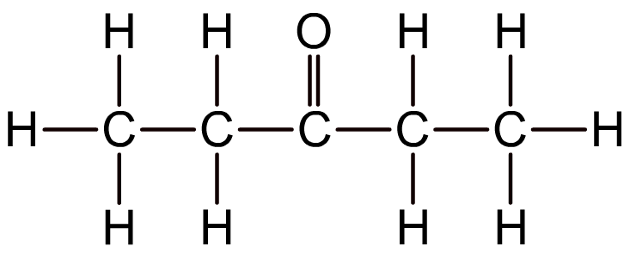
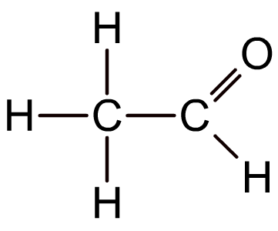
Nomenclature
A
B
C
G
E
F
D
I
J

Slide 5
Bonding

Slide 6
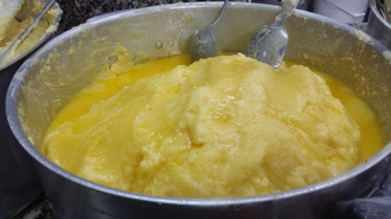
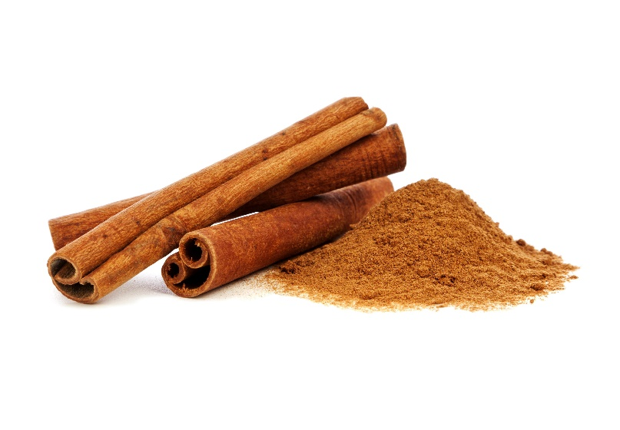
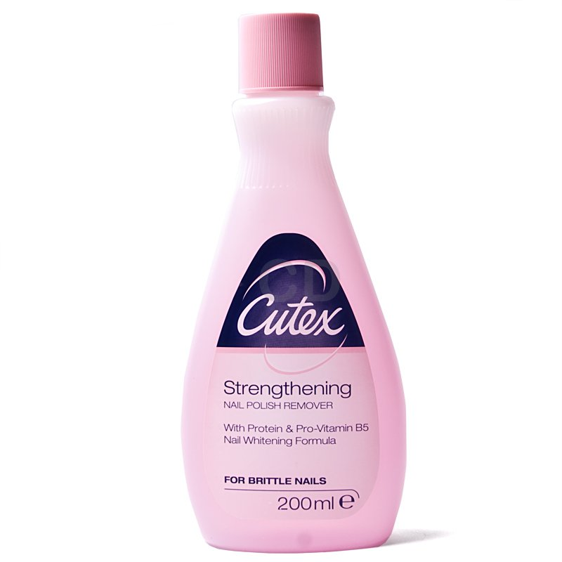
Physical Properties
Notes:
Rancid butter – butanal
Nonanal – roses
Propanone – nail polish remover

Slide 7
Physical Properties of Carbonyl Compounds
Complete the worksheet
Discuss boiling points of aldehydes and ketones

Slide 8
Do Now Questions
1. Explain why:
No ketone with fewer than three carbons is possible
No numbering system is needed in the ketone, butanone
No numbering is ever needed to locate the position of the C=O group when naming aldehydes.
2. Explain why there are no hydrogen bonds between propanone molecules.
3. Explain why hydrogen bonds can form between propanone and water molecules.
Notes:
2. Because all the hydrogen atom are joined to carbon atoms
3. Because the oxygen from the carbonyl group can bond with the hydrogen from the water

Slide 9
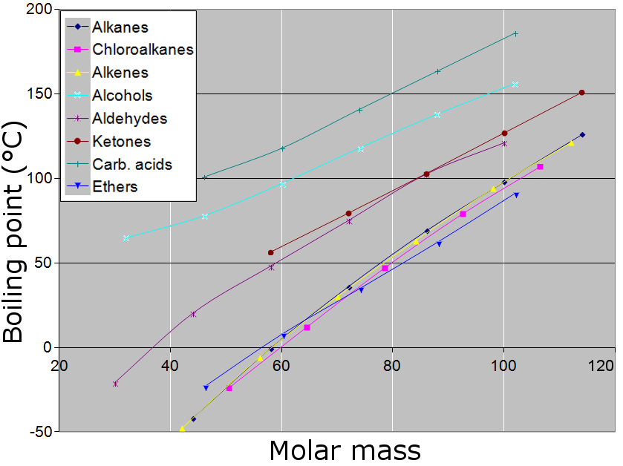

Slide 10
Boiling points and intermolecular forces
The general increase in boiling points from alkanes to aldehydes/ketones and alcohols is due to the intermolecular forces between each type of molecule.
Alkanes are only held together by van der Waals forces. These forces increase with the size/length of a molecule.
The polar carbonyl group in aldehydes and ketones means that as well as van der Waals forces, these molecules are also held together by dipole–dipole interactions.
Alcohols are held together by van der Waals forces and dipole–dipole interactions. In addition, these molecules can form hydrogen bonds with each other, due to the slightly positive hydrogen atom of the hydroxyl group.
Notes:
Teacher notes
See the Boardworks AS Chemistry ‘Bonding and Intermolecular Forces’ presentation for more information about intermolecular forces, including van der Waals forces, permanent dipole–dipole interactions and hydrogen bonding.
See the Boardworks AS Chemistry ‘Alcohols’ presentation for more information about the structure and properties of alcohols.

Slide 11
Solubility in Water
Shorter chain aldehydes and ketones mix completely with water.
Longer chain aldehydes and ketones do not.
Why?

